Slide 1
Statistics Statistics in the media
Year 11 Essentials

Slide 2
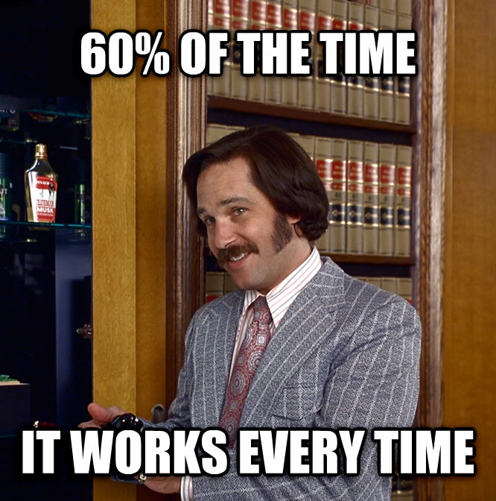

Slide 3
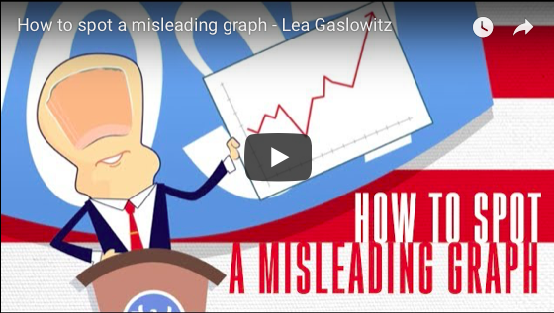
If the embedded video doesn’t work:
https://www.youtube.com/watch?time_continue=67&v=E91bGT9BjYk

Slide 4
24
7
30
Topic: Statistics
Date: /06/2018
EQ – Can statistics tell lies?
There are 5 types of misuse of statistics
Faulty Polling - Specific wording patterns have a persuasive effect and induce respondents to answer in a predictable manner.
Flawed Correlation - studies can be manipulated (with enough data) to prove a correlation that does not exist
Data Fishing - extremely large volumes of data are analysed for the purposes of discovering relationships between data points that have no
Misleading Data Visualisation – If a graph doesn’t show the scale used, the starting value and the method of calculation you should not trust it
Purposeful Bias - the deliberate attempt to influence data findings without even feigning professional accountability

Slide 5
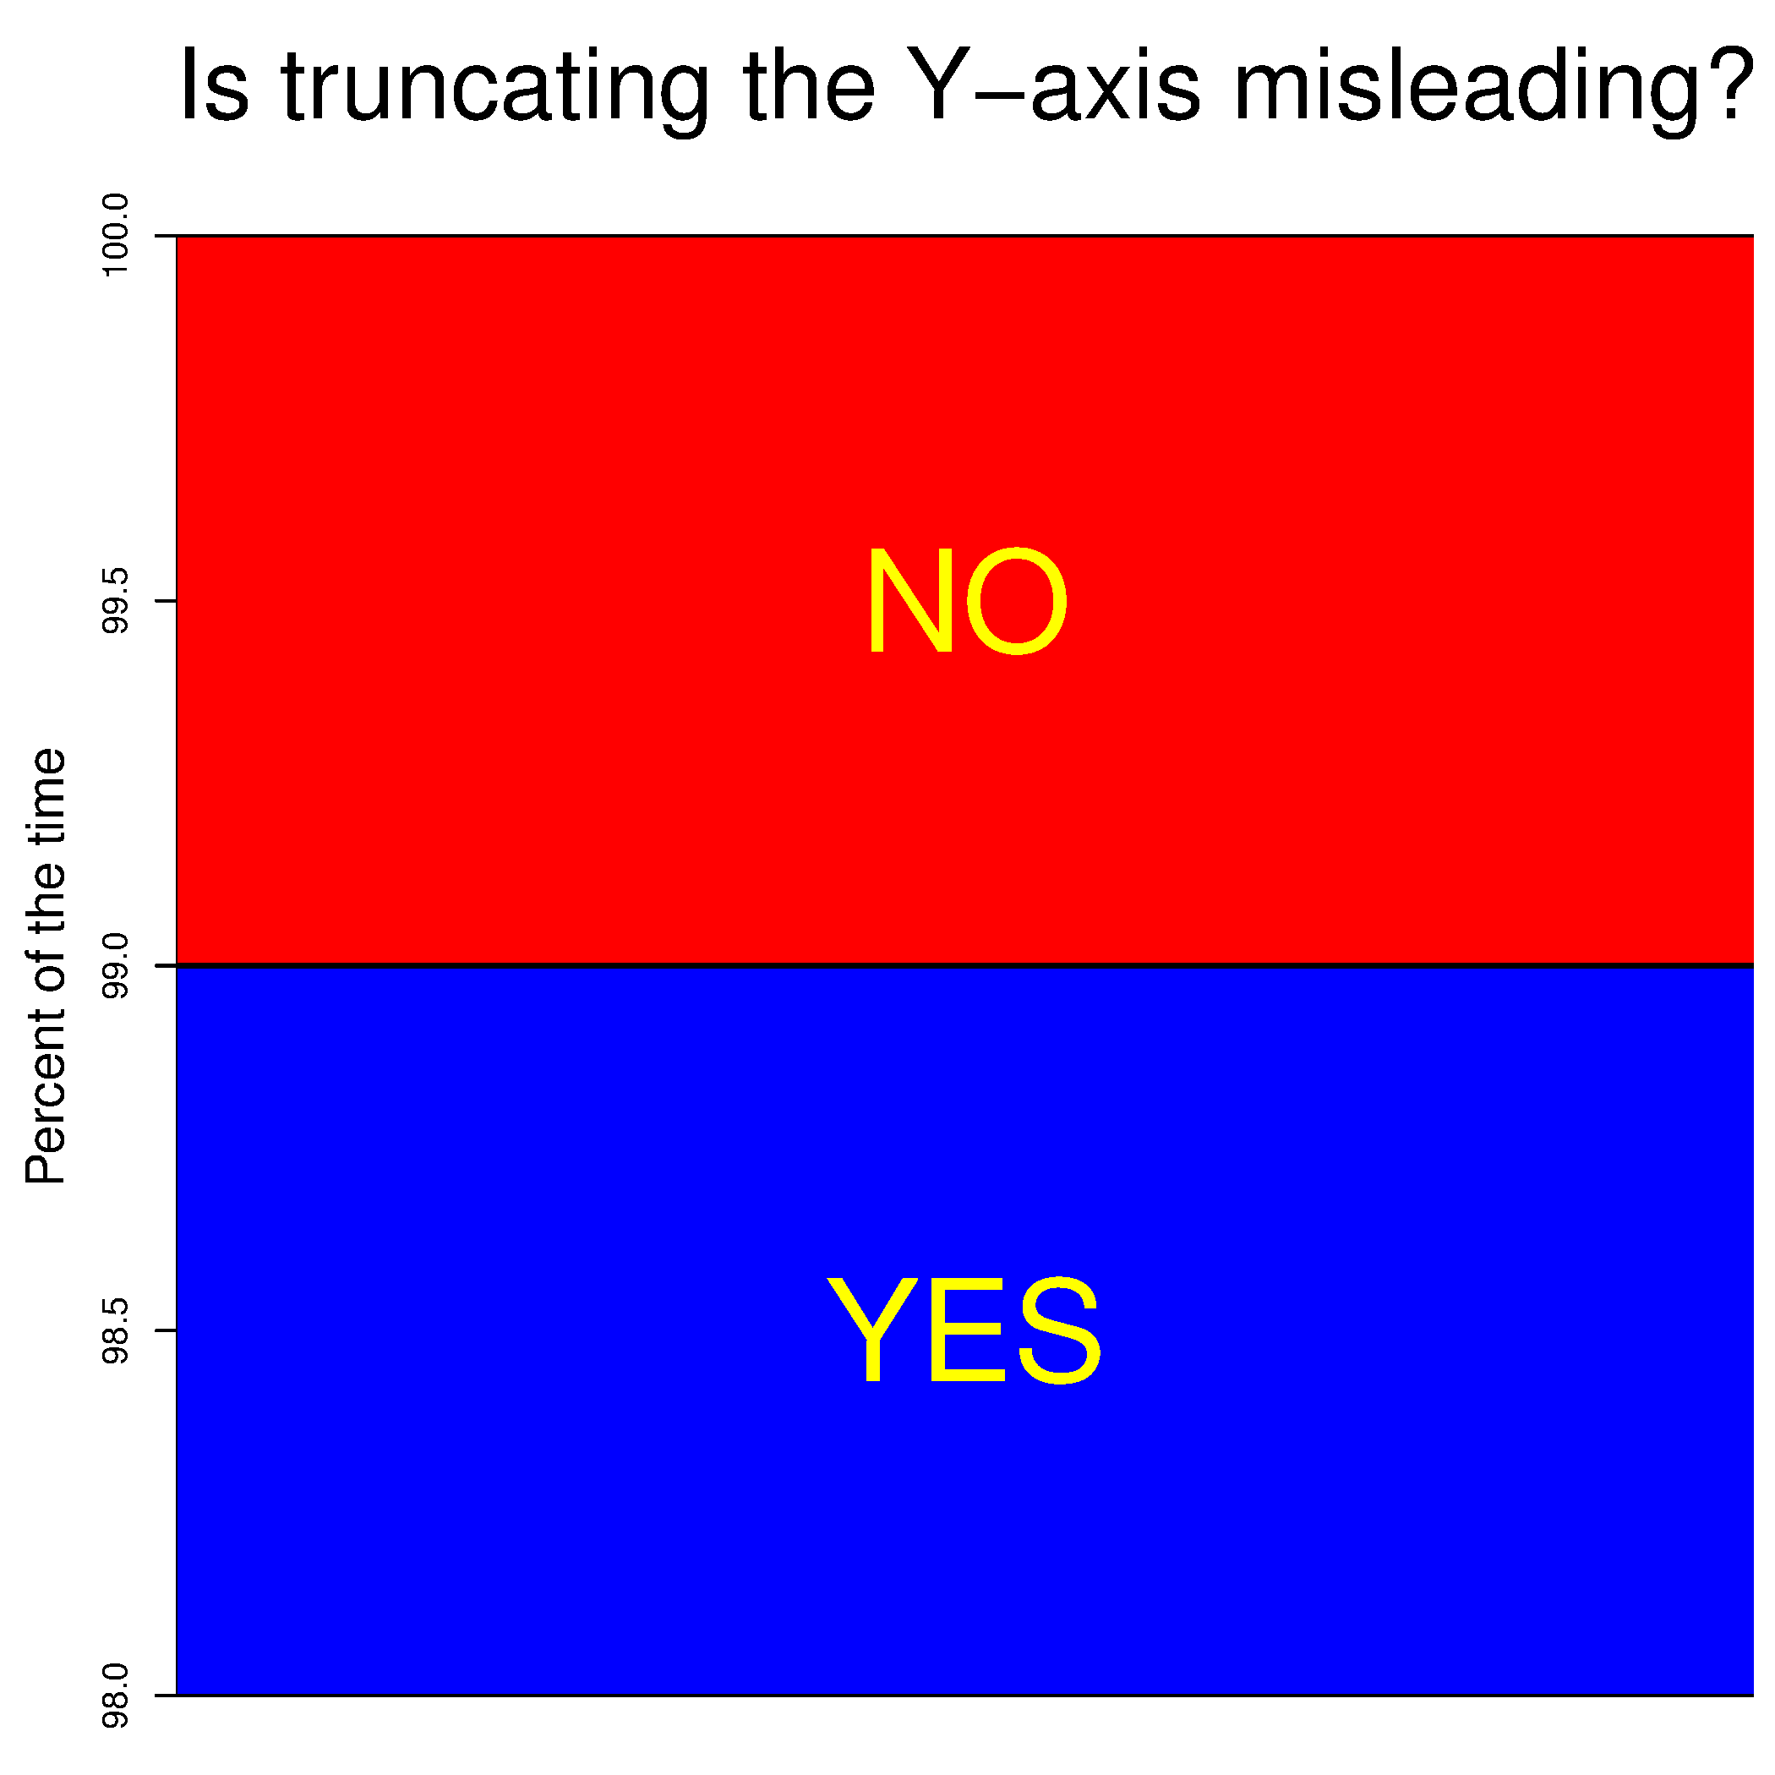
24
7
30
Topic: Statistics
Date: /06/2018
EQ – Can statistics tell lies?

Slide 6
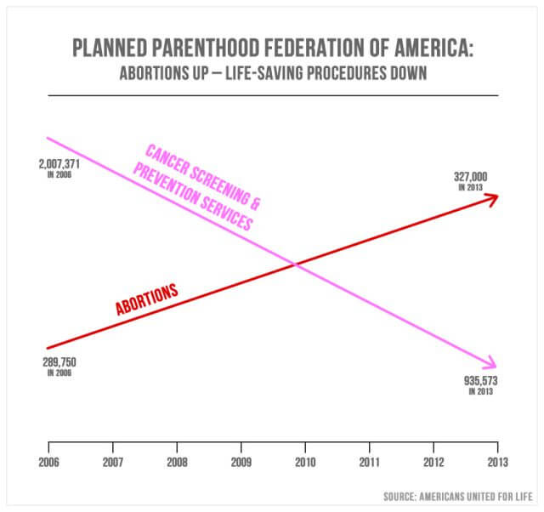
24
7
30
Topic: Statistics
Date: /06/2018
EQ – Can statistics tell lies?

Slide 7
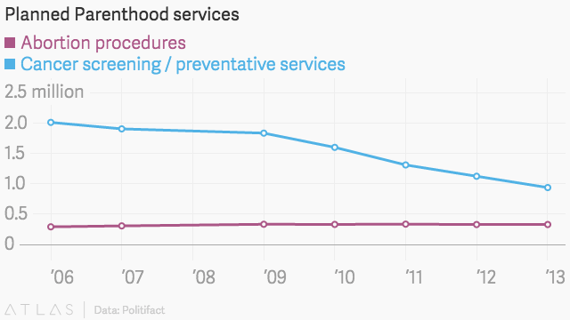
24
7
30
Topic: Statistics
Date: /06/2018
EQ – Can statistics tell lies?
This graph shows the exact same data, but tells a very different story
The scale is shown
The starting value is used (and it starts at zero)

Slide 8
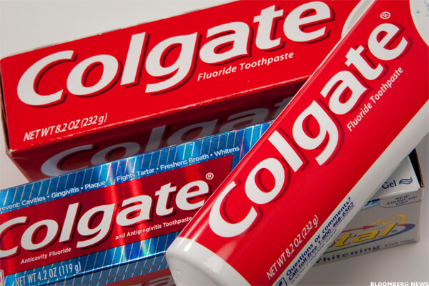
24
7
30
Topic: Statistics
Date: /06/2018
EQ – Can statistics tell lies?
Colgate toothpaste had a famous slogan: “More than 80% of Dentists recommend Colgate”. In 2007, this slogan was deemed in court to be misleading.
In pairs, discuss:
What comes to mind when you read that slogan?
What limitations are there if you take this to mean Colgate is the best brand?
Why might the court have ruled it to be misleading?
The courts ruled that this claim would be understood by readers to mean that 80% of dentists recommend Colgate over and above other brands, and the other 20% would recommend other brands. What the actual survey showed was that competitior’s brands were recommended just as must as Colgate, so the implied meaning in Colgate’s ad (that it was the preferred choice) was misleading.

Slide 9
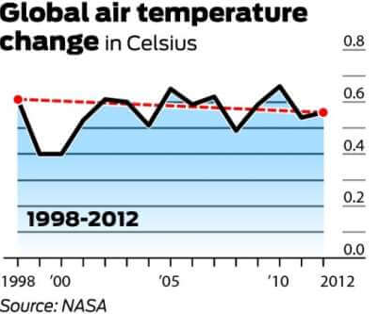
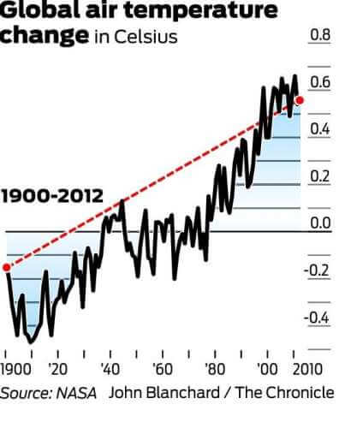
24
7
30
Topic: Statistics
Date: /06/2018
EQ – Can statistics tell lies?
Notice how the scale of the x-axis leads to two very different stories.

Slide 10
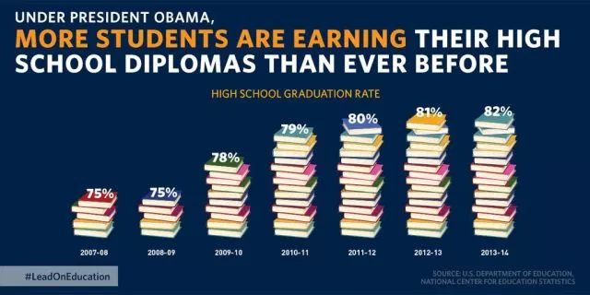
24
7
30
Topic: Statistics
Date: /06/2018
EQ – Can statistics tell lies?
The truncated y axis is a warning sign. The scale is another warning sign – 5 books is 75%, 16 books is 82%

Slide 11
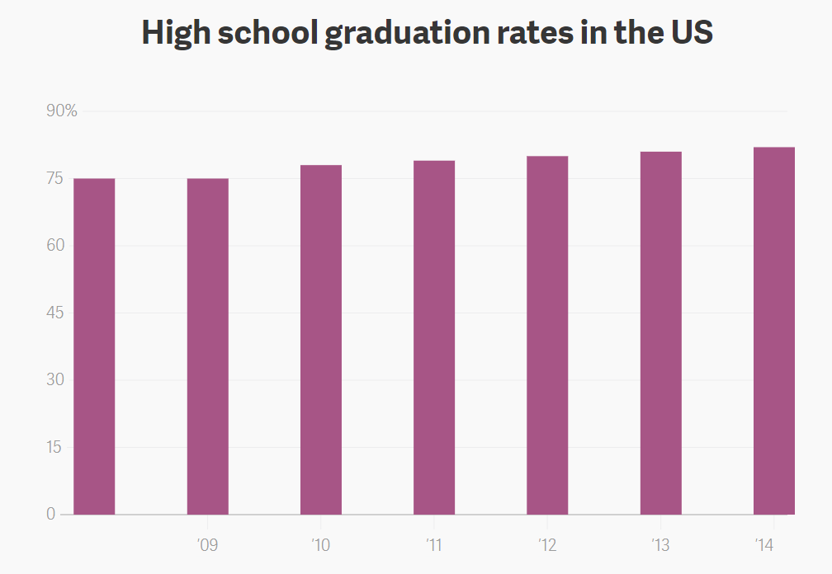
24
7
30
Topic: Statistics
Date: /06/2018
EQ – Can statistics tell lies?
Shown this way it shows only a very slight increase

Slide 12
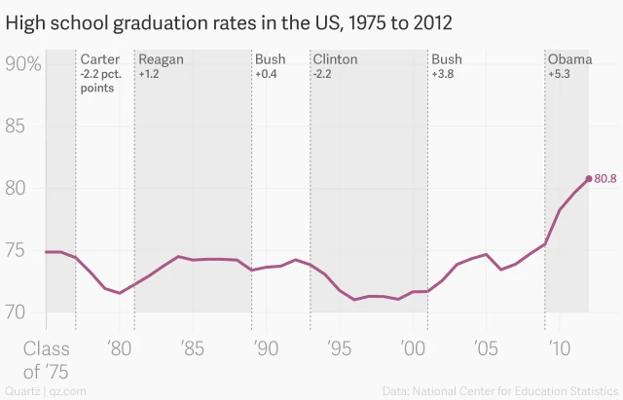
24
7
30
Topic: Statistics
Date: /06/2018
EQ – Can statistics tell lies?
If we look at the same data over a longer timeframe that there is a general increase that started in 2000 and continued in 2008 – 2012.

Slide 13
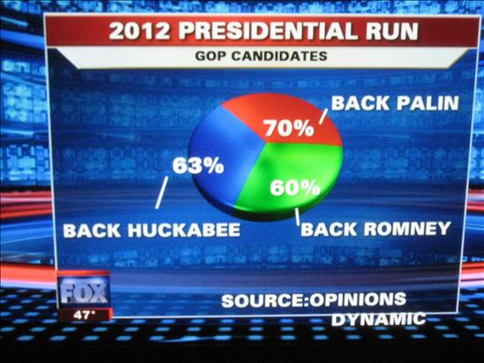
24
7
30
Topic: Statistics
Date: /06/2018
EQ – Can statistics tell lies?
Terrible…

Slide 14
24
7
30
Topic: Statistics
Date: /06/2018
EQ – Can statistics tell lies?
If we look at the same data over a longer timeframe that there is a general increase that started in 2000 and continued in 2008 – 2012.

Slide 15
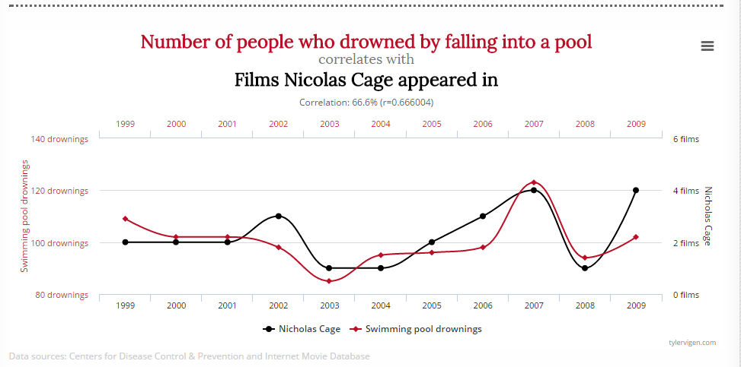
24
7
30
Topic: Statistics
Date: /06/2018
EQ – Can statistics tell lies?
Correct use of statistics is essential when making government policies
Solution: Kill Nicolas Cage and stop all pool drownings.

Slide 16
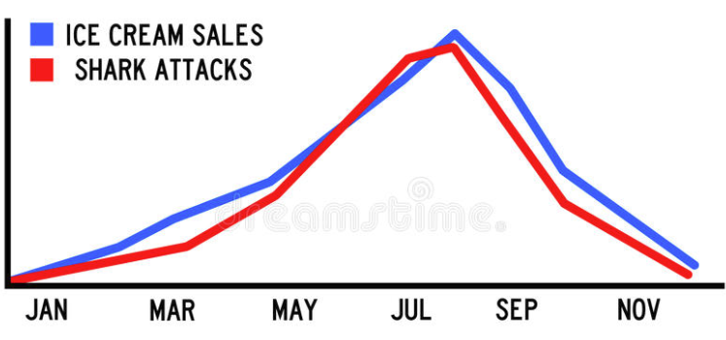
24
7
30
Topic: Statistics
Date: /06/2018
EQ – Can statistics tell lies?
Correct use of statistics is essential when making government policies
Solution: Ban ice cream and prevent all shark attacks

Slide 17
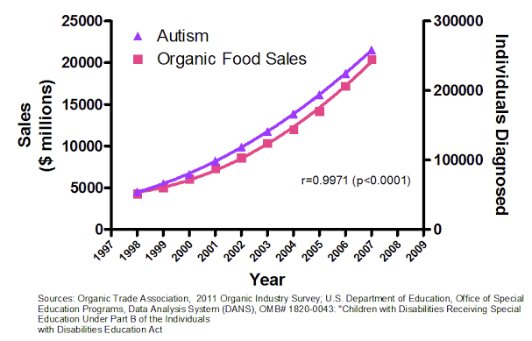
24
7
30
Topic: Statistics
Date: /06/2018
EQ – Can statistics tell lies?
Correct use of statistics is essential when making government policies
Solution: Ban organic food and cure Autism

Slide 18


Slide 19
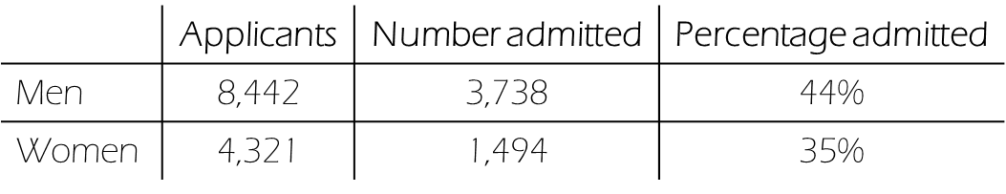
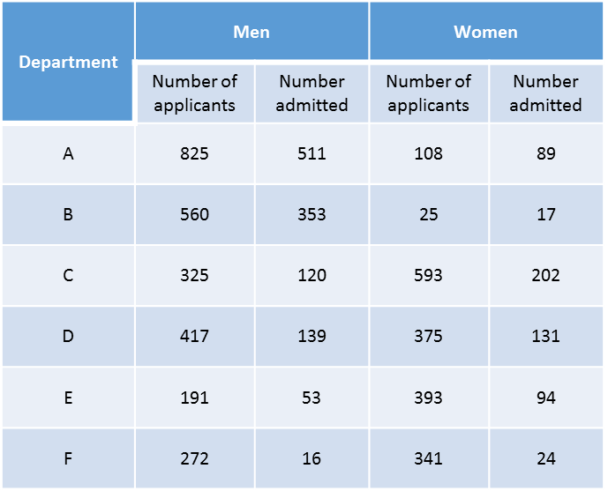
Task
People – we’ve got a problem!
Graduate school admission stats have just come through.
Are we opening ourselves up to a sex bias lawsuit?
Looked into this and we might have the exact opposite problem to worry about (departments left unnamed to protect the innocent):
Check out those percentages!
Compare the percentages and write two news headlines that tell the exact opposite story
Notes:
In 1973 the University of California in Berkeley accepted 44% of male applicants and 35% of female applicants to its graduate school. Concerned that it could be faced with an accusation of sex bias, the university investigated further. It was discovered that of its six departments, four accepted a higher proportion of female applicants, and the other two had only a very slightly higher percentage of males.
This is an example of Simpson’s paradox, in which one trend appears in several distinct groups of data, but when the data is combined the trend reverses or disappears. It was eventually concluded that women tended to apply to competitive departments with low admission rates while men applied to less competitive departments with high admission rates.
This case is intriguing and counter-intuitive. Students studying this example should be encouraged to research and design their own example of the paradox.

Slide 20
Misleading Statistics Worksheet

